Slide 1
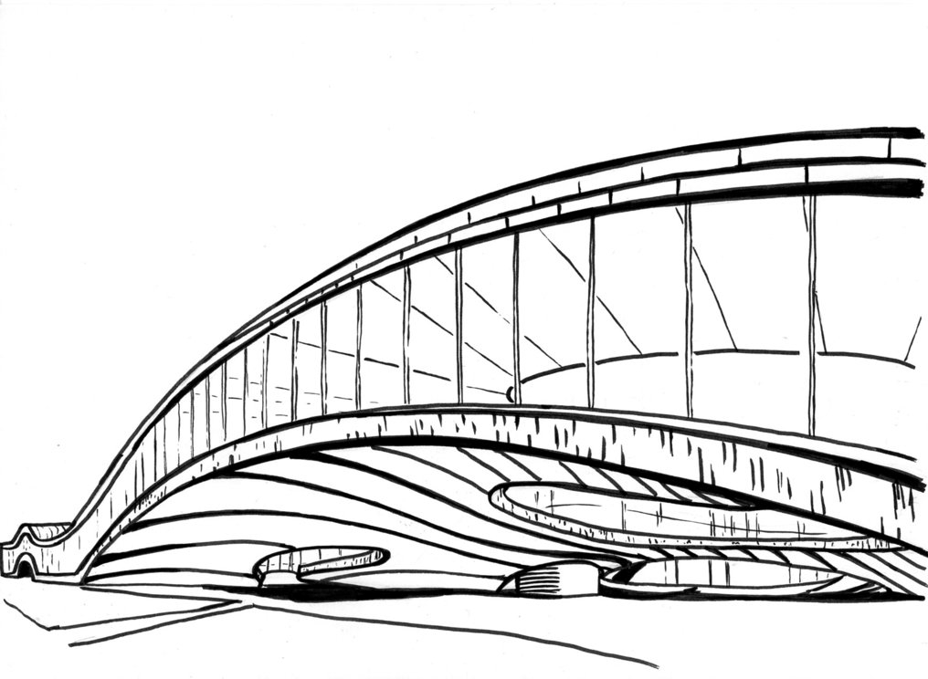
Deep Learning for Logic Optimization Algorithms
Winston Haaswijk¹, Edo Collins², Benoit Seguin³,
Frédéric Kaplan³, Sabine Süsstrunk², Mathias Soeken¹, Giovanni De Micheli¹
¹Integrated Systems Laboratory, EPFL
²Image and Visual Representation Lab, EPFL
³Digital Humanities Laboratory, EPFL

Slide 2
Deep Learning for EDA
In our lab work has been done in two major directions
1. Human-free EDA
Configure existing EDA tools automatically, no human in the loop
2. Learning Novel Algorithms
Use deep learning to create new algorithms
Discover algorithm hyperparameter settings
Discover design flows [1]
This talk: train agent to optimize Majority Inverter Graphs (MIGs)
Potential to achieve results that are outside scope of existing algorithms
[1] Cunxi Yu, Houping Xiao, Giovanni De Micheli. Developing Synthesis Flows without Human Knowledge. DAC’18

Slide 3
Motivation
Why learn new algorithms?
We have not reached the limits of logic optimization
Open questions
Theoretical: can machine learning be applied to any effect?
Novel synthesis methods unlock significant improvements
Potentially find more improvements using this new approach
Practical: can it yield state-of-the-art results?

Slide 4
Outline
Background
Deep learning
Formalization
Viewing logic optimization as a game
Reinforcement learning
MIGs and majority algebra
Deterministic markov decision process
Applying Deep Reinforcement Learning
Scoring functions and optimality
Neural network model
Rewards and training
Experimental Results
Size- and depth optimization of small functions
Generalization
MCNC benchmarks

Slide 5
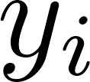
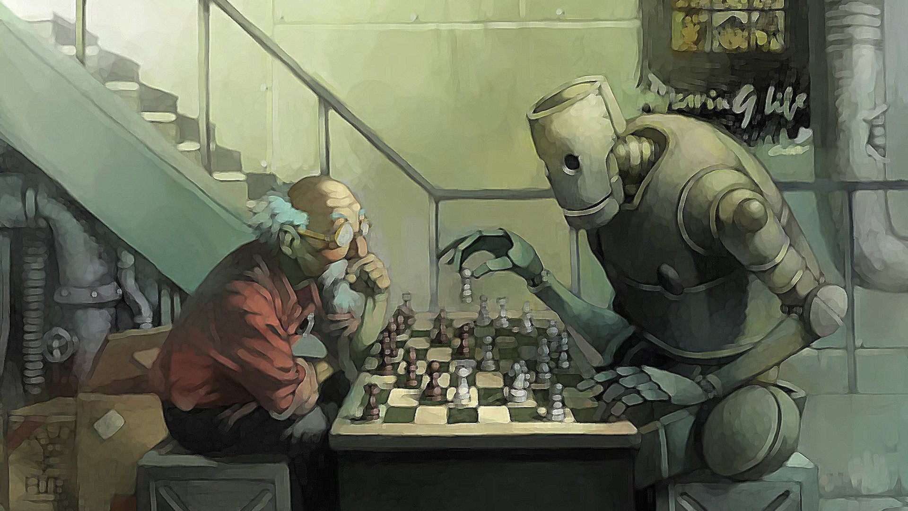
Reinforcement Learning (RL)
Learn which actions to take in an environment
NNs are usually trained in a supervised way
Using I/O pairs from a ground-truth data set
: “given input the output should be ”
Problem: this is not always possible!
Which chess move is “correct” given game state?
Other examples:
Self-driving cars
Controlling robot arm
Many others….

Slide 6
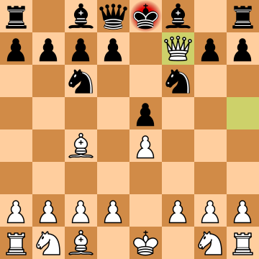
The (Deep) RL Paradigm
Given: a state of the environment at time
Agent is allowed to take actions
(but not told which action is correct!)
Different actions lead to different rewards
Take action and receive reward
Agent should learn which actions lead to good rewards
In other words: learn a policy function
Assigns probabilities to actions given a state
Is the probability of applying move when in state
Parameterized by
Discount later rewards using
Deep RL: use deep NN to estimate

Slide 7
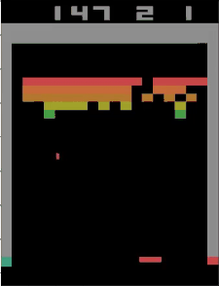
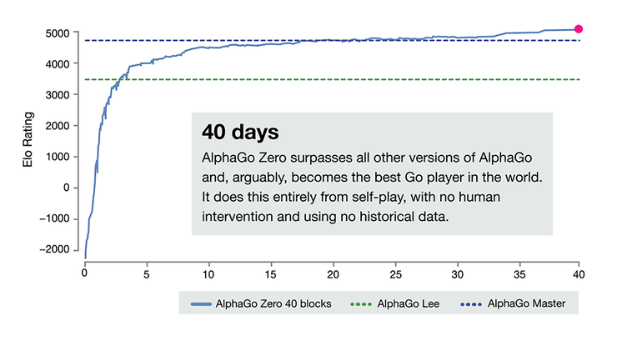
Deep RL: a success story
Learning to play Atari games [2]
AlphaGo: first superhuman Go player [3]
AlphaGo Zero: learning from scratch [4]
[2] Mnih, V. et al. Playing Atari with Deep Reinforcement Learning. NIPS’13
[3] Silver, D. et al. Mastering the game of Go with deep neural networks and tree search. Nature’16
[4] Silver, D. et al. Mastering the game of Go without human knowledge. Nature’18

Slide 8
Majority-Inverter Graphs (MIGs)
A data structure to represent Boolean functions
Majority version of And-Or-Inverter graphs (AIGs)
A directed-acyclic graph
Every node is a ternary majority operator
Edges may be complemented
Introduced by Luca Amaru [5]
AIG vs. MIG
[5] L. G. Amaru, et al. Majority-inverter graph: A novel data-structure and algorithms for efficient logic optimization. DAC’14

Slide 9
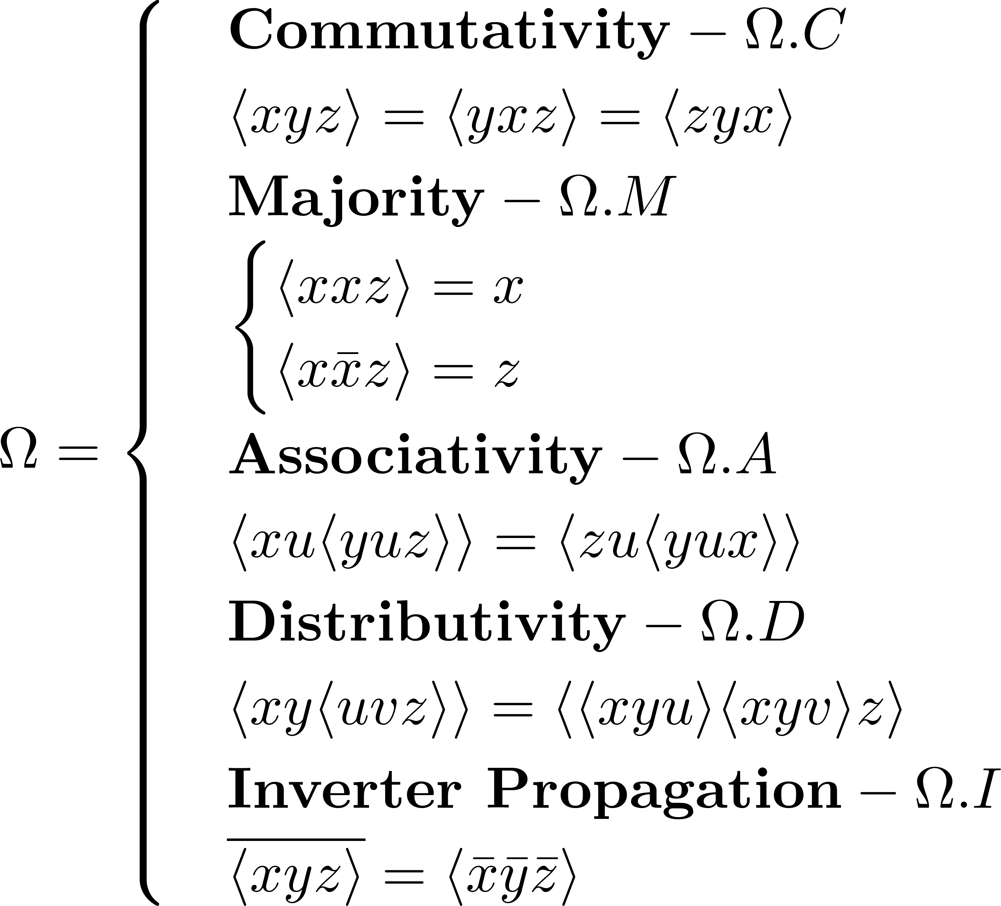
Majority Algebra
“The most interesting operator in the universe” – Donald Knuth
Operator induces sound & complete Boolean algebra
Close correspondence between algebra and MIGs
Can use algebra to manipulate MIGs
Reach (theoretically) any point in MIG design space
Has yielded significant improvements in logic optimization
Problem: given MIG, which rules to apply?
This talk: learning to optimize MIGs

Slide 10
Desirable Algorithm Properties
1. Autonomous
System learns heuristics automatically
2. Generalizing
Train on small functions, infer on larger ones
No human intervention required
3. Multi-output
Intrinsically supports optimization of multiple-output functions
No need to handle them as special case
4. Generic
Use the same algorithm for different optimization objectives
E.g. size- and depth-optimization
5. Approximate
Variable amount of work can be put in
We can stop optimization at any point and obtain a result
This is not possible in some other methods (e.g. exact synthesis)
Notes:
Desirable properties of the system that I’ll describe

Slide 11
Logic Optimization as a Game

Slide 12
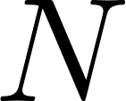
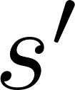
Formalization
States and Moves
Game state: logic network
Transitions
Applying move to state results in state
Move: sound manipulation of network
Should preserve functional equivalence
Define
Write
Given a sequence of moves
Write

Slide 13
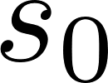
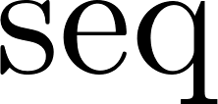
Formalization (continued)
Optimization
Define function
Playing the Game
Given initial state
Depends on optimization objective
e.g. size or depth
Find good sequences
Such that
Maximizing
Ideally find such that is optimum
Notes:
Finding optimum may be impossible in practice

Slide 14
Our Specific Optimization Game
The Game in This Work
Game states: MIGs
Legal moves: given by median algebra
Motivation
This game is sound and complete:
Given any initial MIG
Theoretical guarantee (even if not practically achievable)
There exists a sequence such that: & is optimum:

Slide 15
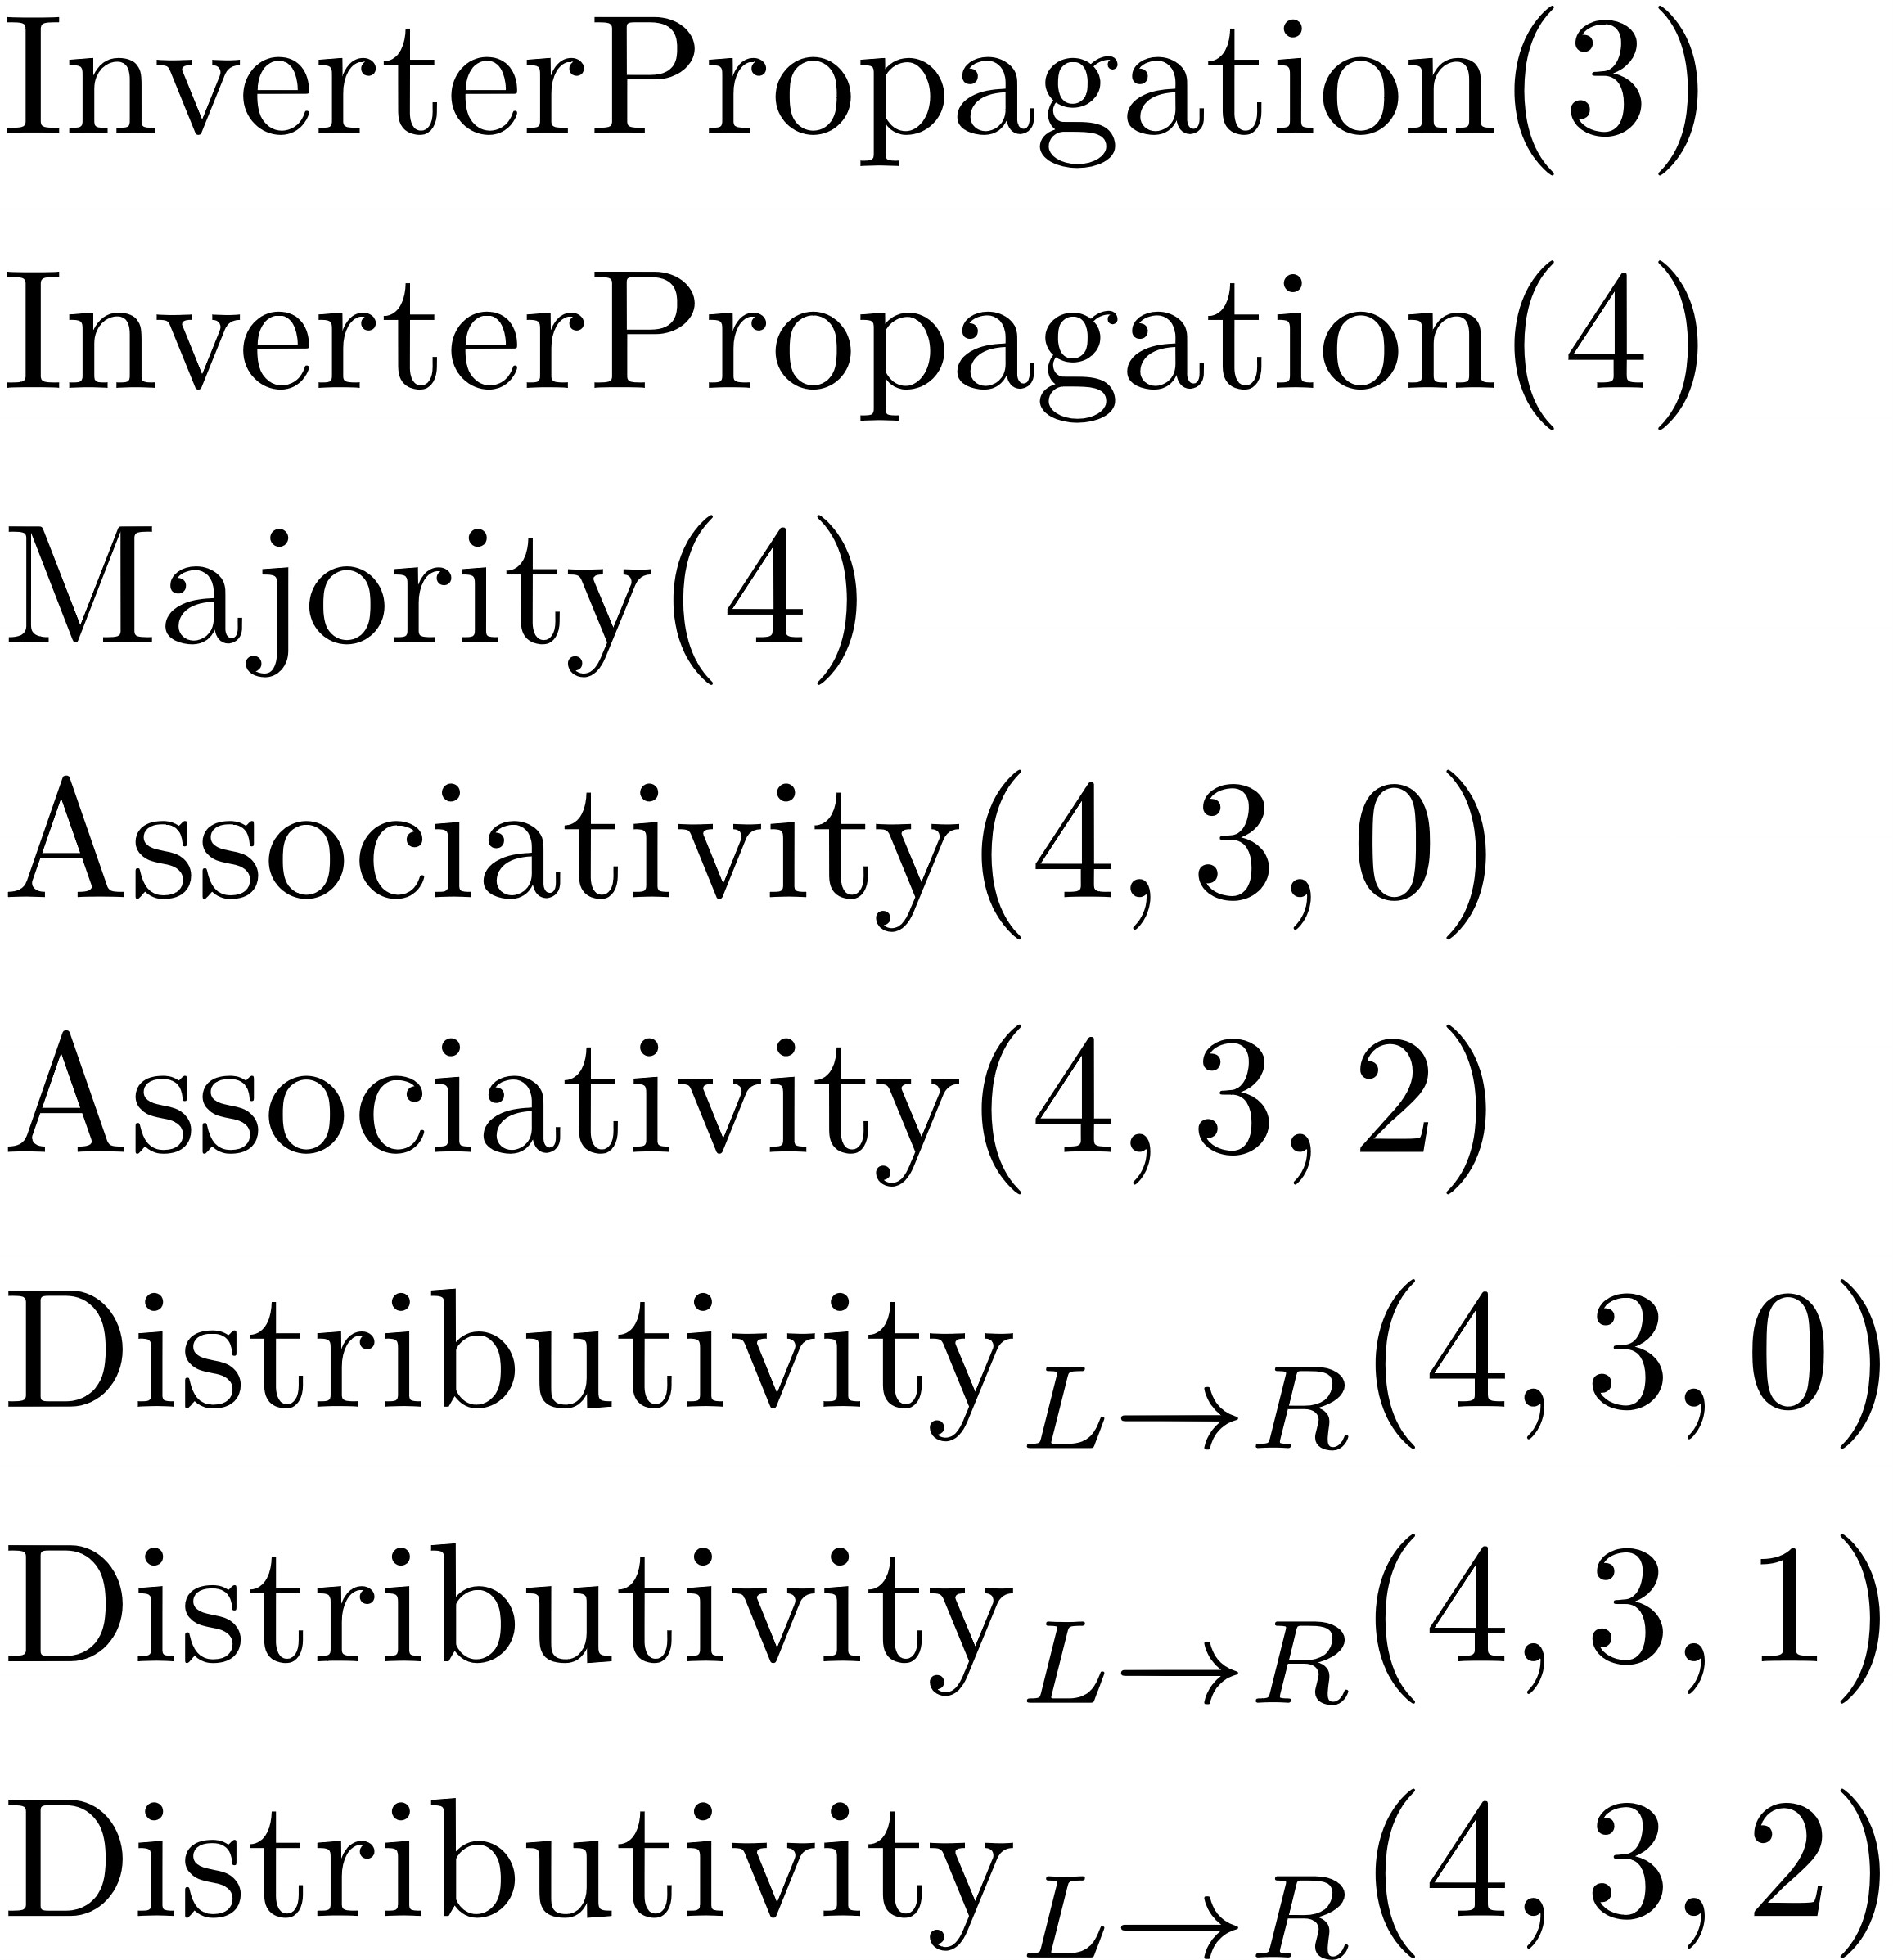
Example Game State

Slide 16
Learning to Play
Takeaways
Train a deep neural network to play optimization game
Major Challenge: Learning Graph Structure
The MIG representation is “problematic”
Learn to play using reinforcement learning
NN architectures to process graphs are rare
Graph input size varies
Unlike typical grid-like inputs such as images or chess boards
We want to be invariant to graph symmetries
Still an open research area

Slide 17
Learning Graph Structure
Main Idea
Learn node embeddings
Solution: Message-Passing Neural Networks
Recently formulated by Google DeepMind [6]
Representations of local graph structure
Invariant to graph properties
Various symmetries
Graph size
In the context of Quantum Chemistry
[6] Gilmer, J. et al. Neural Message Passing for Quantum Chemistry. ICML’ 17

Slide 18
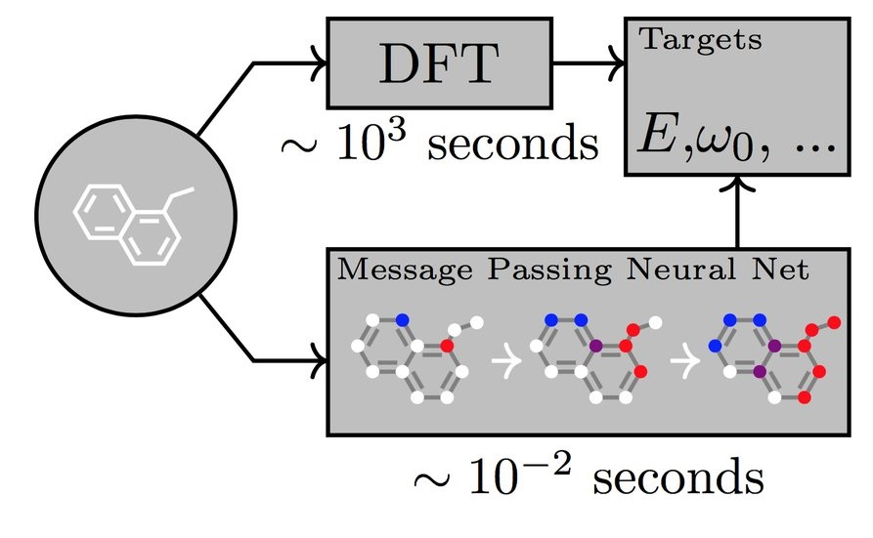
Message-Passing Neural Networks (MPNNs)
General framework for learning graph structure
Recently formulated by Google Deepmind
Applied in Quantum Chemistry
Predicting molecule properties
Much faster than quantum simulation
Allows us to learn both local and global graph structure
Local structure is captured by node embeddings
In this work we only use local structure

Slide 19
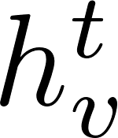
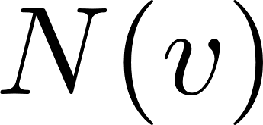
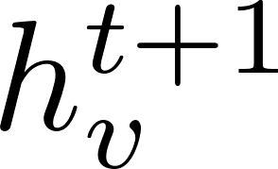
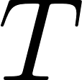
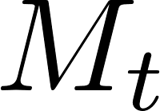
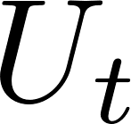
Message Passing
Consider a node in a graph
denotes feature vector of at time
Let denote the neighbors of
The feature vector is updated by messaging
First, aggregate messages from neighbors:
Then, use received messages to update:
We iterate this phase for steps
Note
Embeddings are independent of graph size
and are learned functions (e.g. NNs)
determines size of receptive field

Slide 20
Training: Reinforcement Learning
MPNN is initialized with random parameters
We update these by playing the optimization game
Training occurs in rollouts of n moves
Start from initial state and apply n moves
This is how we learn policy
We use the standard policy gradient technique

Slide 21
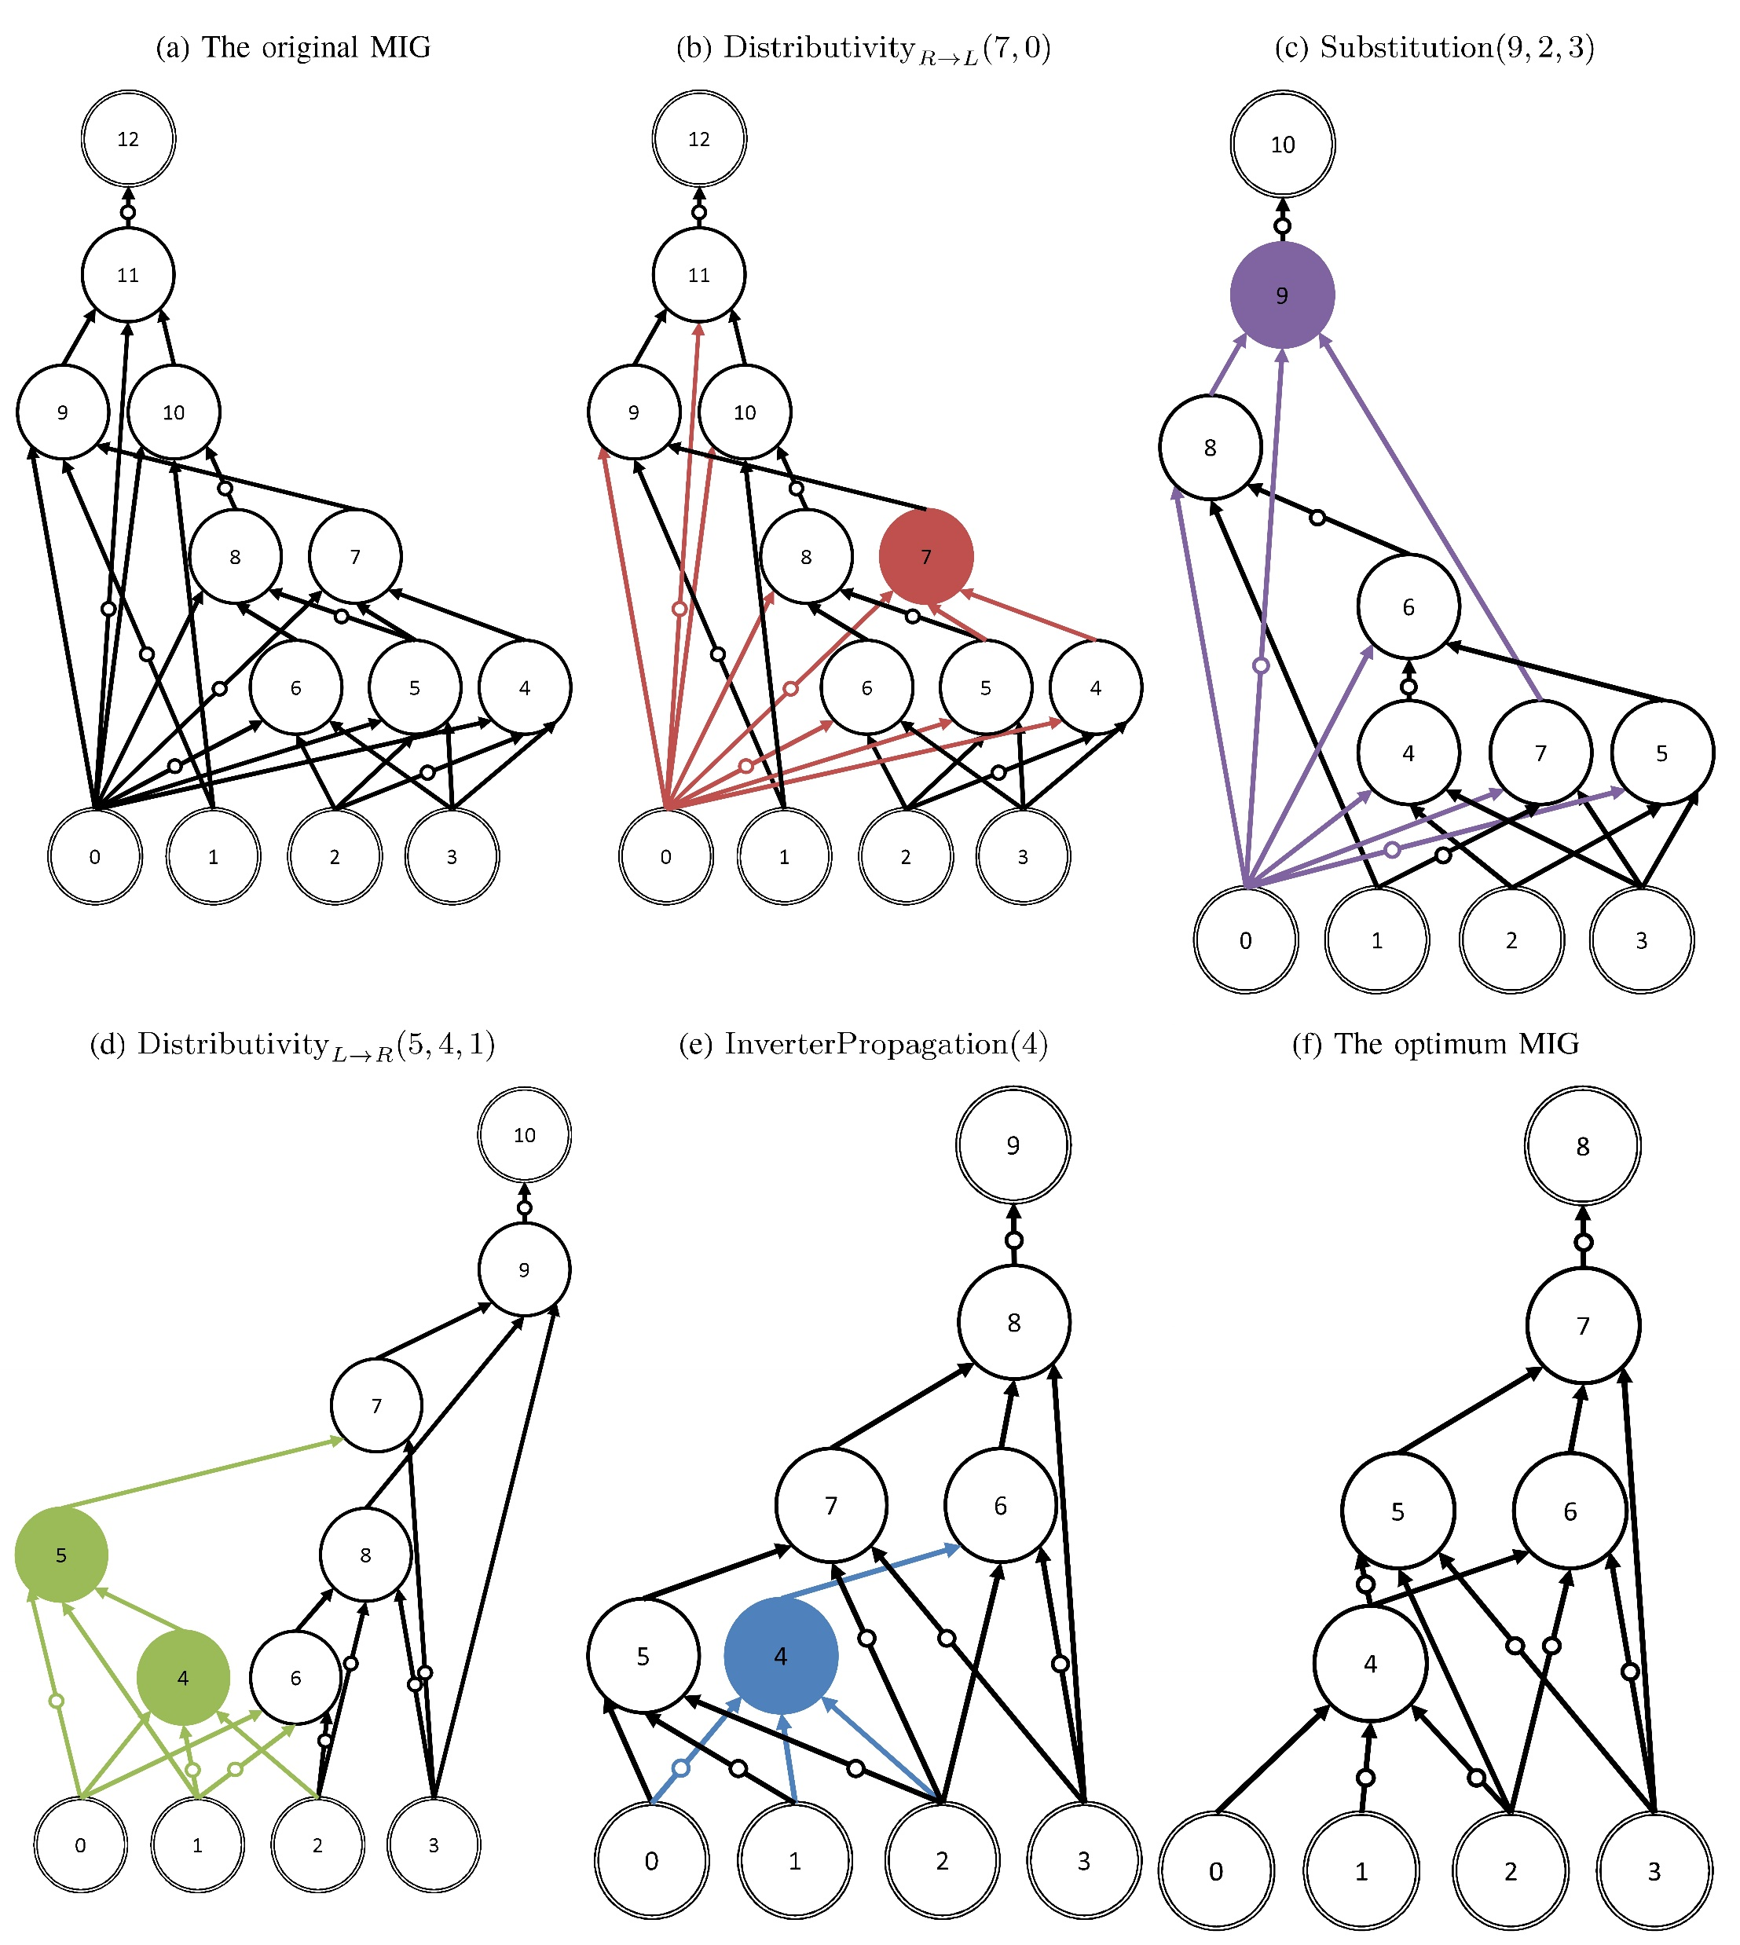
Inference
Network learns to optimize MIGs
Optimization depends on objective function
Inference: given MIG, predict which move to make
Notes:
What does inference look like?

Slide 22
Experiments

Slide 23
Starting Small
Size Optimization of Small Functions
Consider all 256 3-input functions
Result
This works!
Decompose functions into MIGs (Shannon/Boole decomposition)
These MIGs represent initial game states
We learn to find size-optimum MIGs for all 3-input functions
Experiment
We have a ground truth: optimum MIGs found using Cirkit
Can our agent find the optimum?
Train on data set using rollouts with n = 5
Using less than 20 steps of inference
Average runtime: 2ms per MIG (averaging over parallel batch)

Slide 24
Scaling and Generalizing
Scaling
3-input functions are perhaps not so interesting
Generalizing
Training takes time
Can we train and infer on larger networks?
Training on small functions is faster than larger ones
Preferred scenario:
Train on n-input functions
Infer on m-input functions (m > n)
Notes:
Ideally m may be much bigger than n

Slide 25
Scaling and Generalizing: Results
Compared to state-of-the-art ABC logic synthesis package
Training on 4-input functions, inference on 6-input functions
Takeaways:
Runtime is competitive
Generalizes: 4-input model can optimize 6-input functions
Can be composed with other optimization methods
PI = Potential Improvement
CRT = Conventional synthesis Runtime
IRT = Inference Runtime
DSD = Disjoint Support Decomposable
Notes:
We compare with both exact and heuristic results
DSD = disjoint support decomposable

Slide 26
MCNC Depth Optimization
Compare to ABC’s resyn2 script
Selection of MCNC benchmarks
Compare depth optimization
Agent learns depth optimization
Up to 47.4% improvement
Notes:
B9 improvement: 12.5%
Count improvement: 47.4%
My_adder improvement: 14.3%

Slide 27
Desirable Algorithm Properties
1. Autonomous
System learns heuristics automatically
2. Generalizing
Train on small functions, infer on larger ones
No human intervention required
3. Multi-output
Intrinsically supports optimization of multiple-output functions
No need to handle them as special case
4. Generic
Use the same algorithm for different optimization objectives
E.g. size- and depth-optimization
5. Approximate
Variable amount of work can be put in
We can stop optimization at any point and obtain a result
This is not possible in some other methods (e.g. exact synthesis)
Notes:
Some comments to reflect on the system we have described so far

Slide 28
Conclusion
Contributions
Show the feasibility of applying AI techniques to create new logic optimization algorithms
Open Challenges
Improvements to neural network architecture
Ensure completeness in move generation
Potential solution: declarative move generation
Connecting MPNNs and MIGs
NNs for graphs still very much unsolved
Scaling our solution
By training NNs to recognize optimization opportunities in DAG structures
Using MPNNs and Reinforcement Learning

Slide 29
Thanks for Your Attention
Contact
winston.haaswijk@epfl.ch
https://github.com/whaaswijk

